Slide 2
What environmental problems do you know?
Global warming
Greenhouse effect
Extinction of animals
Loss of biodiversity
Acid rains
Depletion of natural resources
Soil erosion
Ozone layer depletion
Air pollution
Sea pollution
Noise pollution
Radioactive contamination

Slide 3
Do you agree these are the most serious problems?
Global warming
Deforestation
Climate change
Acid rains
Urban sprawl

Slide 5
Group 1

Slide 6
Group 2

Slide 7
Choose the main message of our lesson
Ecological problems are really serious.
All the ecological problems are interconnected.
Everybody can do their share in helping the environment.
Ordinary people cannot do anything to help our environment.
It is time to do something before it is too late.

Slide 8
Let’s discuss
Have we reached our goal?
Has Mathematics helped you?
Has our lesson changed your attitude?
Can you change your life a little bit to help the environment?

Slide 9
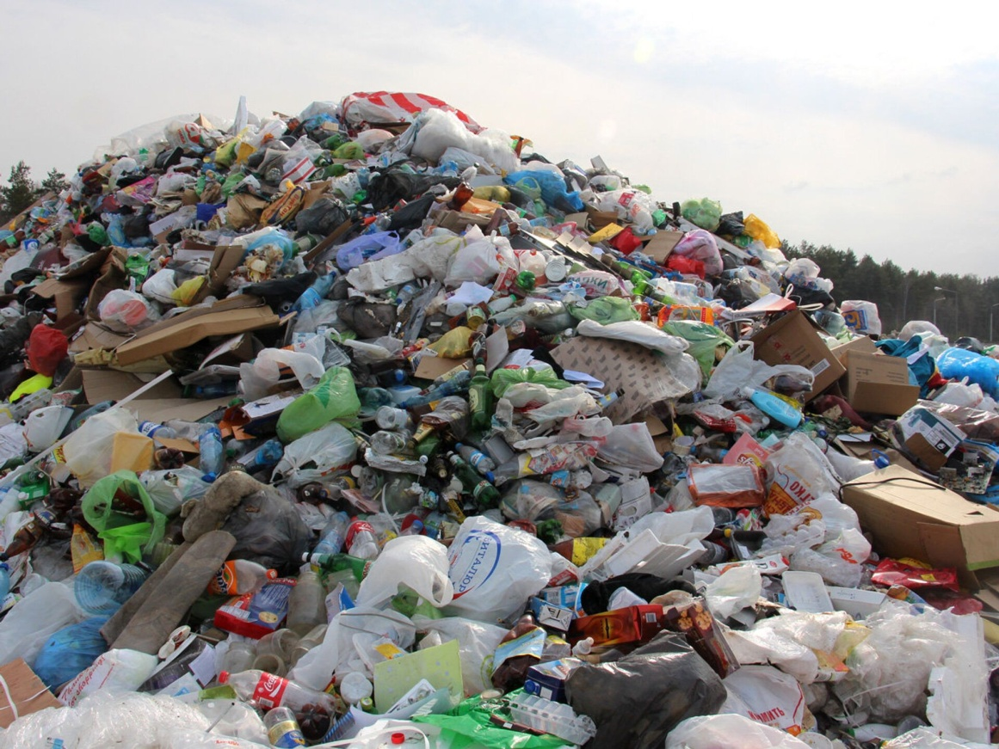
Homework
Solve the task and make the logical sequence.
Be ready to present it to the class.

